Slide 1
Optical Fiber Communication

Slide 2
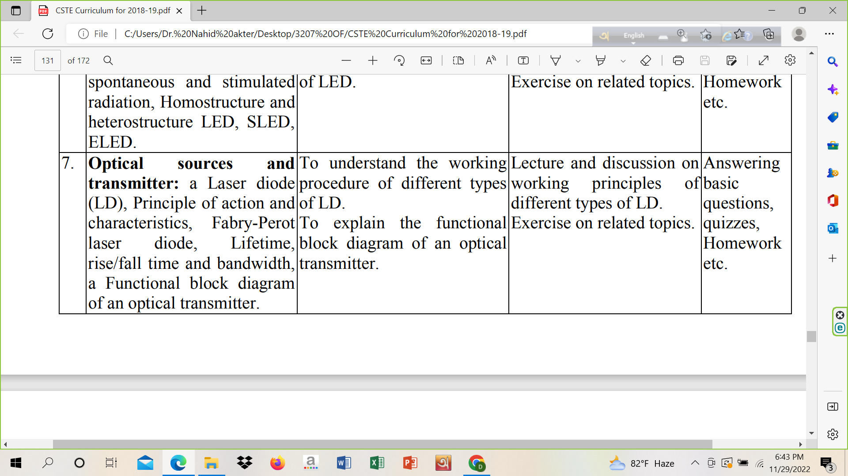

Slide 3
LASER
Light Amplification by Stimulated Emission
of Radiation

Slide 4
LASER
A laser is a device that emits light through a process of optical amplification based on the stimulated emission of electromagnetic radiation.

Slide 5
Laser Diode
Laser diodes play an important role in our everyday lives. They are very cheap and small. Laser diodes are the smallest of all the known lasers. Their size is a fraction of a millimeter. Laser diodes are also known as semiconductor lasers, junction lasers, junction diode lasers or injection lasers.
A laser diode works on the principle of 1.stimulated emission.
There are three types of emissions:
Stimulated absorption
Stimulated emission
Spontaneous emission
2.Population inversion
3.Cavity resonance for light amplification

Slide 6
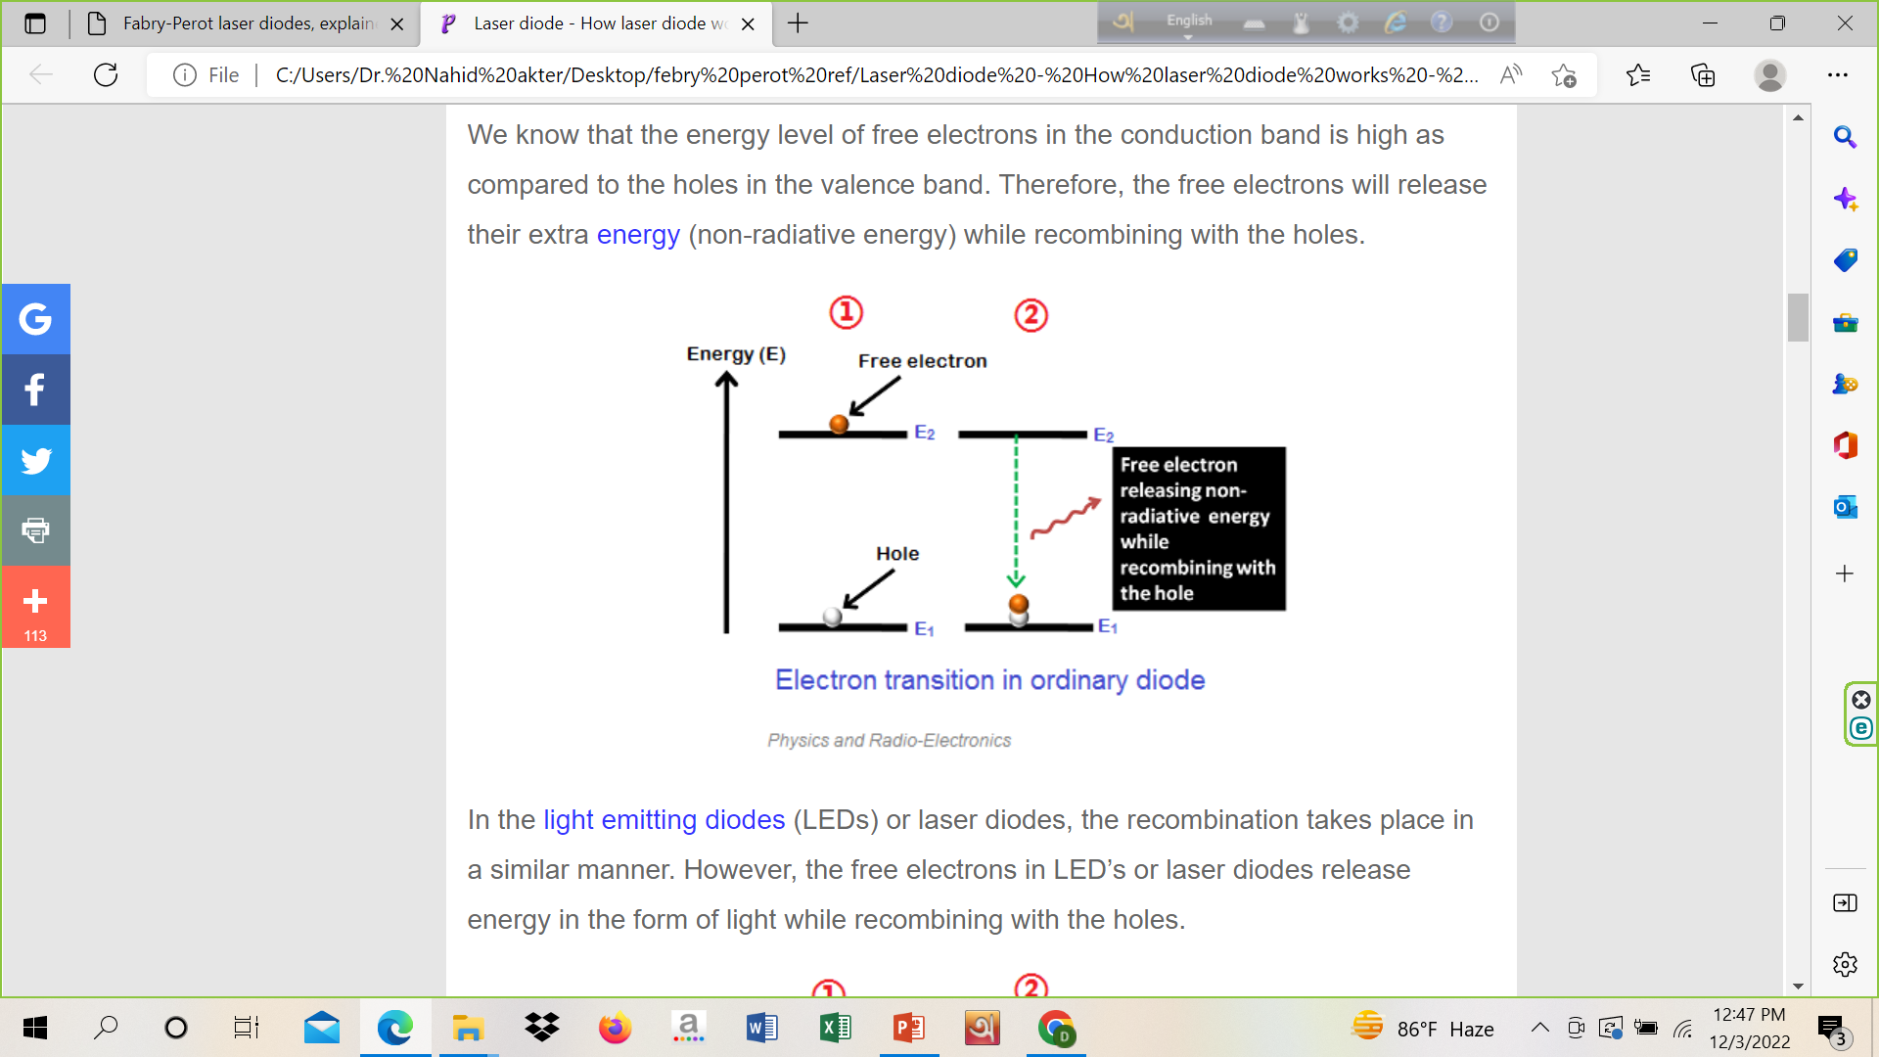
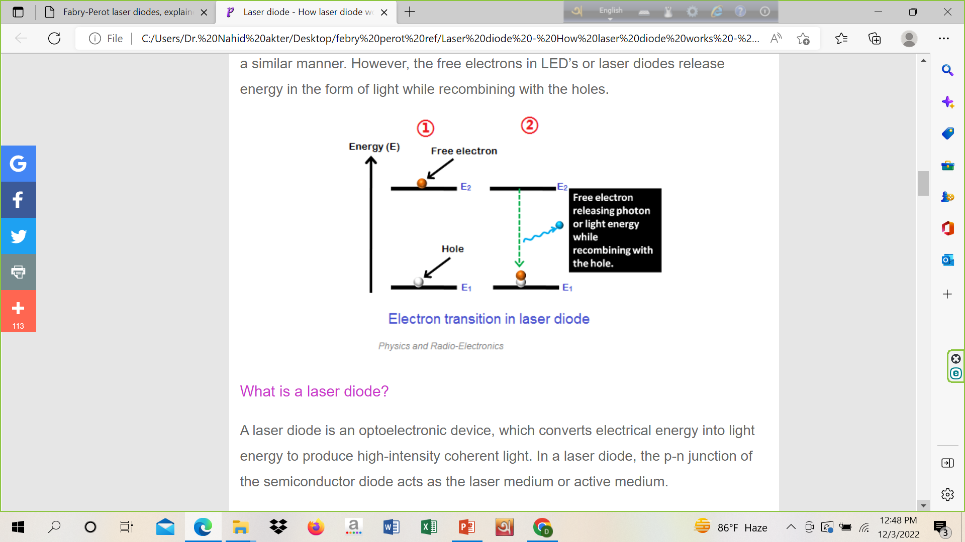

Slide 7
Laser Diode
A laser diode is an optoelectronic device, which converts electrical energy into light energy to produce high-intensity coherent light. In a laser diode, the p-n junction of the semiconductor diode acts as the laser medium or active medium.
The working of the laser diode is almost similar to the light emitting diode (LED). The main difference between the LED and laser diode is that the LED emits incoherent light whereas the laser diode emits coherent light.
The laser diode is made of two doped gallium arsenide layers (p type and n type). In laser diodes, selenium, aluminum, and silicon are used as doping agents.

Slide 8
Steps for Stimulated Emission
The main steps required for producing a coherent beam of light in laser diodes are: light absorption, spontaneous emission, and stimulated emission.
Absorption of energy
Absorption of energy is the process of absorbing energy from the external energy sources.
In laser diodes, electrical energy or DC voltage is used as the external energy source. When the DC voltage or electrical energy supplies enough energy to the valence electrons or valence band electrons, they break bonding with the parent atom and jumps into the higher energy level (conduction band). The electrons in the conduction band are known as free electrons.

Slide 9
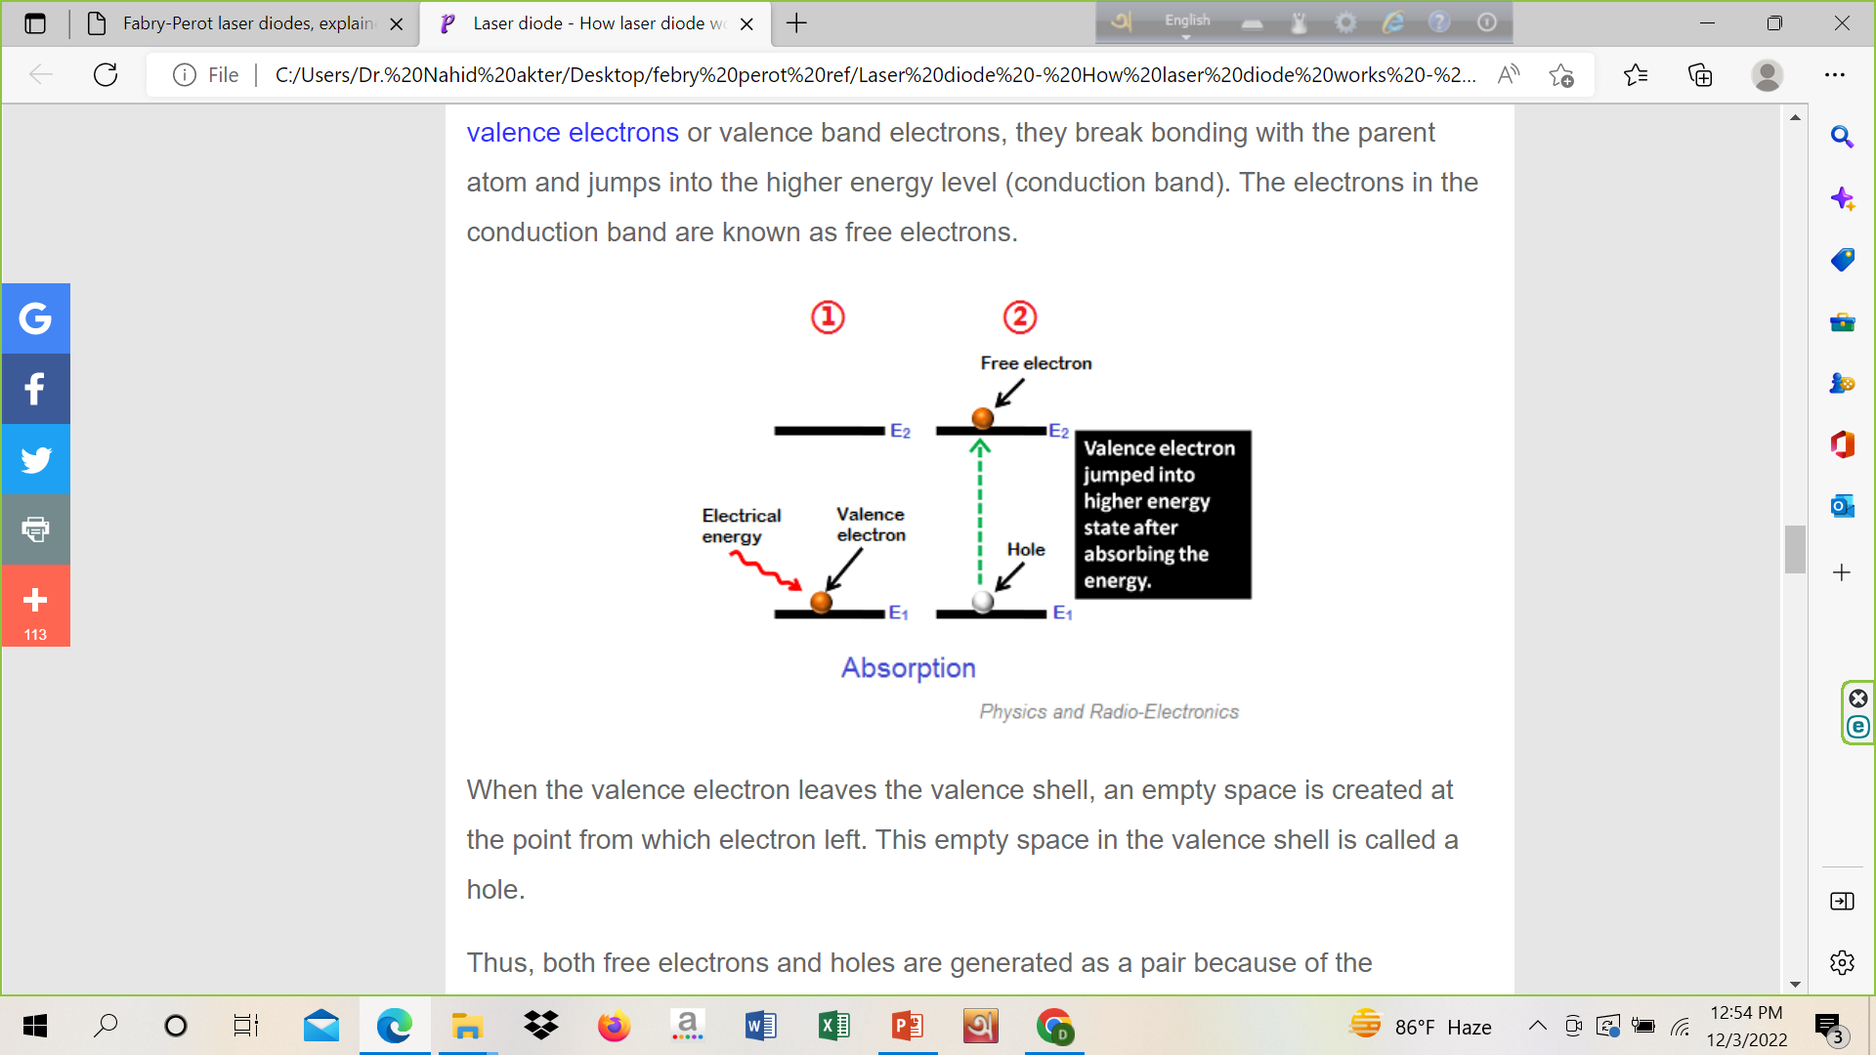
Steps for Stimulated Emission
When the valence electron leaves the valence shell, an empty space is created at the point from which electron left. This empty space in the valence shell is called a hole.
Thus, both free electrons and holes are generated as a pair because of the absorption of energy from the external DC source.

Slide 10
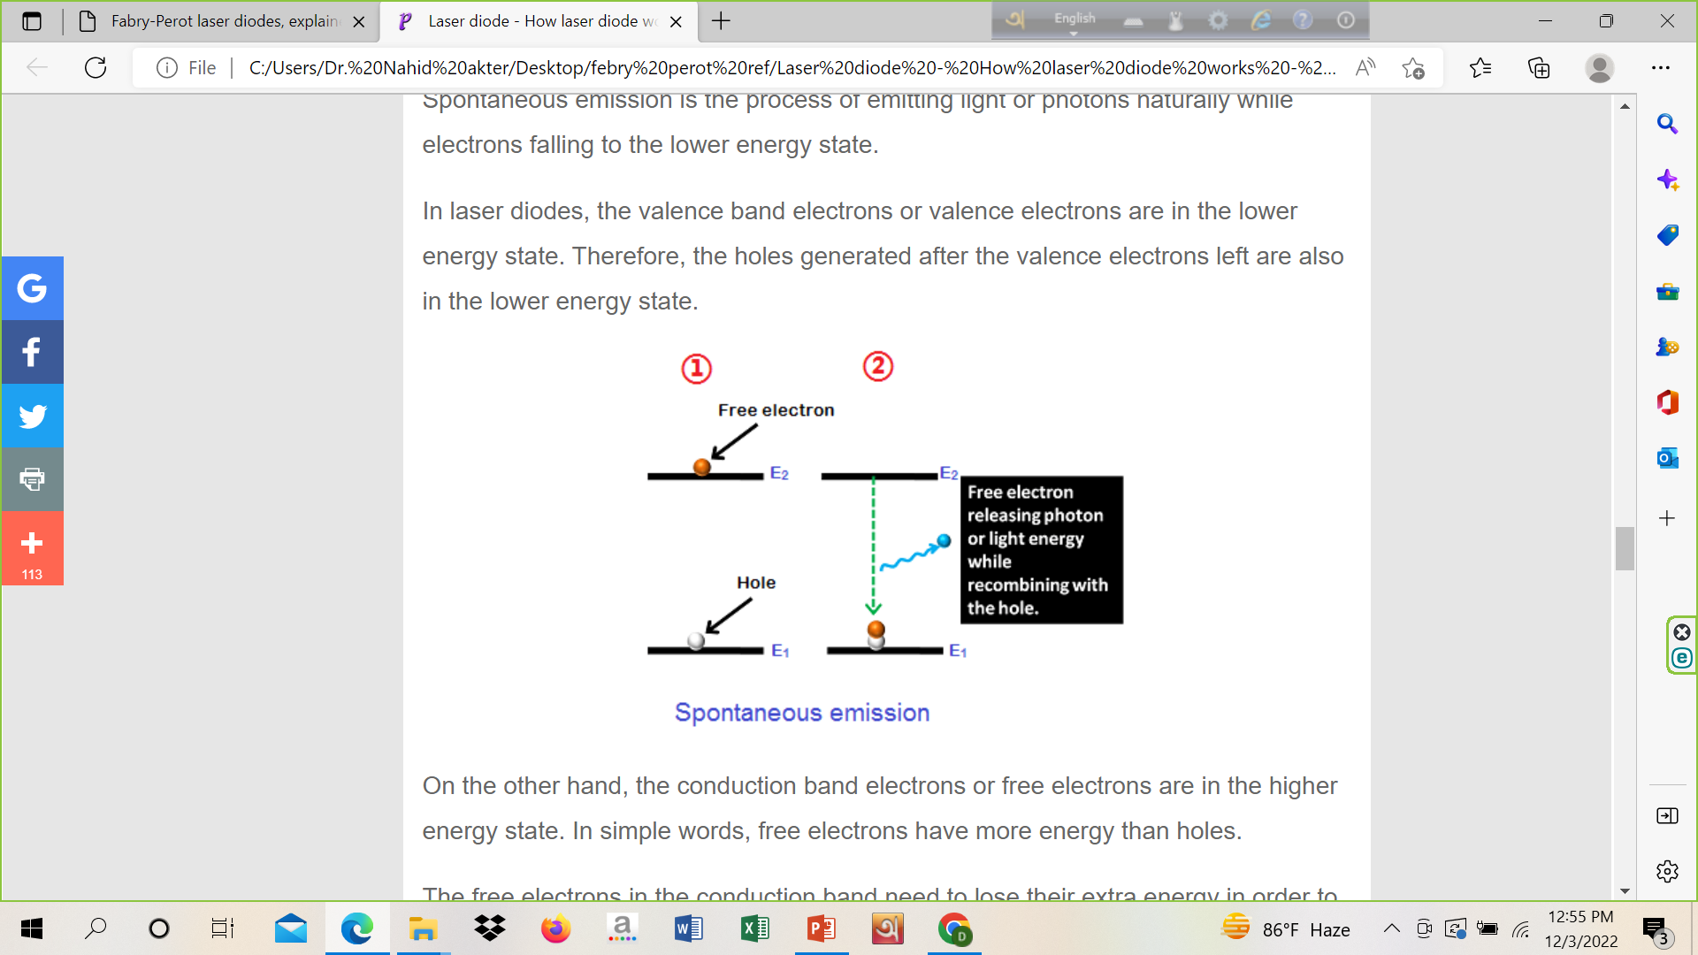
Steps for Stimulated Emission
Spontaneous emission
Spontaneous emission is the process of emitting light or photons naturally while electrons falling to the lower energy state.

Slide 11
Steps for Stimulated Emission
On the other hand, the conduction band electrons or free electrons are in the higher energy state. In simple words, free electrons have more energy than holes.
The free electrons in the conduction band need to lose their extra energy in order to recombine with the holes in the valence band.
The free electrons in the conduction band will not stay for long period. After a short period, the free electrons recombine with the lower energy holes by releasing energy in the form of photons.

Slide 12
Steps for Stimulated Emission
Stimulated emission
Stimulated emission is the process by which excited electrons or free electrons are stimulated to fall into the lower energy state by releasing energy in the form of light. The stimulated emission is an artificial process.
In stimulated emission, the excited electrons or free electrons need not wait for the completion of their lifetime. Before the completion of their lifetime, the incident or external photons will force the free electrons to recombine with the holes. In stimulated emission, each incident photon will generate two photons.
All the photons generated due to the stimulated emission will travel in the same direction. As a result, a narrow beam of high-intensity laser light is produced.

Slide 13
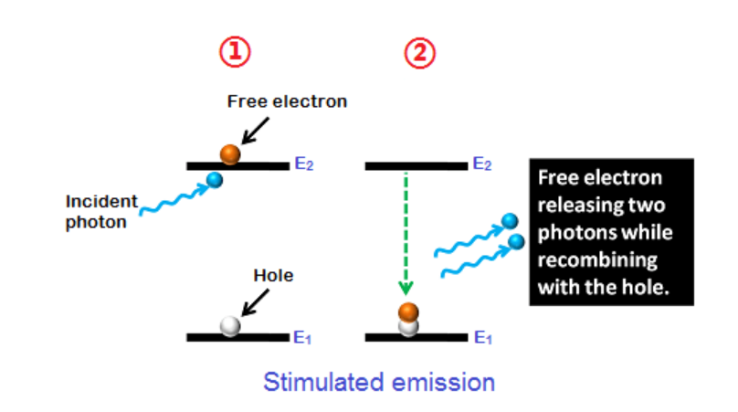

Slide 14
Population inversion and Cavity resonance
for light amplification

Slide 15
Population inversion and resonant cavity
When the number of particles in one excited state exceeds the number of particles in some lower-energy state, population inversion is achieved. When the amount of stimulated emission is larger than the amount of absorption then the light is called amplified. By itself, this makes an optical amplifier. When an optical amplifier is placed inside a resonant optical cavity, one obtains a laser oscillator.
**In a few situations it is possible to obtain lasing with only a single pass of EM radiation through the gain medium, and this produces a laser beam without any need for a resonant or reflective cavity (example: nitrogen laser). Thus, reflection in a resonant optical cavity is usually required for a laser, but is not absolutely necessary.

Slide 16
Gain Medium
The gain (amplifying) medium consist of material with properties that allow it to amplify light by the way of stimulated emission. Light of a specific wavelength that passes through the gain medium is amplified (increases in power). For the feedback laser, amplification caused by optical feedback.
The gain medium of a laser is normally a material of controlled purity, size, concentration, and shape, which amplifies the beam by the process of stimulated emission. The gain medium absorbs pump energy, which raises some electrons into higher-energy ("excited") quantum states.

Slide 17
Optical Resonator
The optical resonator is sometimes referred to as an "optical cavity”. Lasers use open resonators as opposed to the literal cavity. The resonator typically consists of two mirrors between which a coherent beam of light travels in both directions, reflecting back on itself so that an average photon will pass through the gain medium repeatedly before it is emitted from the output aperture or lost to diffraction or absorption. If the gain (amplification) in the medium is larger than the resonator losses, then the power of the recirculation of light can rise exponentially.
But each stimulated emission event returns an atom from its excited state to the ground state, reducing the gain of the medium. With increasing beam power the net gain (gain minus loss) reduces to unity and the gain medium is said to be saturated.
In a continuous wave (CW) laser, the balance of pump power against gain saturation and cavity losses produces an equilibrium value of the laser power inside the cavity; this equilibrium determines the operating point of the laser.

Slide 18
Optical Resonator
If the applied pump power is too small, the gain will never be sufficient to overcome the cavity losses, and laser light will not be produced. The minimum pump power needed to begin laser action is called the lasing threshold.
Ref link: https://www.youtube.com/watch?v=6481t498AMs

Slide 19
Laser Light Characteristics
Stimulated emission produces light that matches the input signal in wavelength, phase, and polarization. This, combined with the filtering effect of the optical resonator gives laser light its characteristic coherence, and may give it uniform polarization and monochromaticity, depending on the resonator's design.
Beam name: Gaussian beam, multimode beams with the transverse modes, top-hat beam, Bessel beams, optical vortexes.
A laser beam profiler is used to measure the intensity profile, width of laser beams.
Example of LASER: He-Ne Laser, Semiconductor Laser etc.

Slide 20
How the laser diode works?
When DC voltage is applied across the laser diode, the free electrons move across the junction region from the n-type material to the p-type material. In this process, some electrons will directly interact with the valence electrons and excites them to the higher energy level whereas some other electrons will recombine with the holes in the p-type semiconductor and releases energy in the form of light. This process of emission is called spontaneous emission.

Slide 21
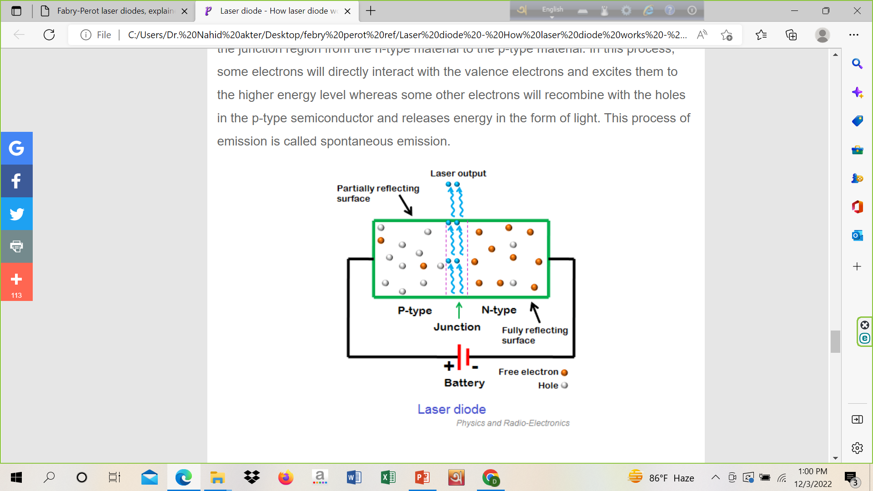

Slide 22
How the laser diode works?
The photons generated due to spontaneous emission will travel through the junction region and stimulate the excited electrons (free electrons). As a result, more photons are released. This process of light or photons emission is called stimulated emission. The light generated due to stimulated emission will moves parallel to the junction.
The two ends of the laser diode structure are optically reflective. One end is fully reflective whereas another end is partially reflective. The fully reflective end will reflect the light completely whereas the partially reflective end will reflect most part of the light but allows a small amount of light.
The light generated in the p-n junction will bounce back and forth (hundreds of times) between the two reflective surfaces. As a result, an enormous optical gain is achieved.

Slide 23
How the laser diode works?
The light generated due to the stimulated emission is escaped through the partially reflective end of the laser diode to produce a narrow beam laser light. All the photons generated due to the stimulated emission will travel in the same direction. Therefore, this light will travel to long distances without spreading in the space.

Slide 24
Advantage/Disadvantage
Advantages
Simple construction
Lightweight
Very cheap
Small size
Highly reliable compared to other types of lasers.
Longer operating life
High efficiency
Mirrors are not required in the semiconductor lasers.
Low power consumption
Disadvantages
Not suitable for the applications where high powers are required.
Semiconductor lasers are highly dependent on temperature.

Slide 25
Application
Laser pointers.
Fiber optic communications.
Barcode readers.
Laser printing.
Optical disk drives.
Laser scanning.
Measuring range and speed.
DNA sequencing instruments.
Laser absorption spectrometry.
laser surgery and skin treatments.
Cutting and welding materials.
Military devices for marking targets.
Laser lighting displays for entertainment.

Slide 26
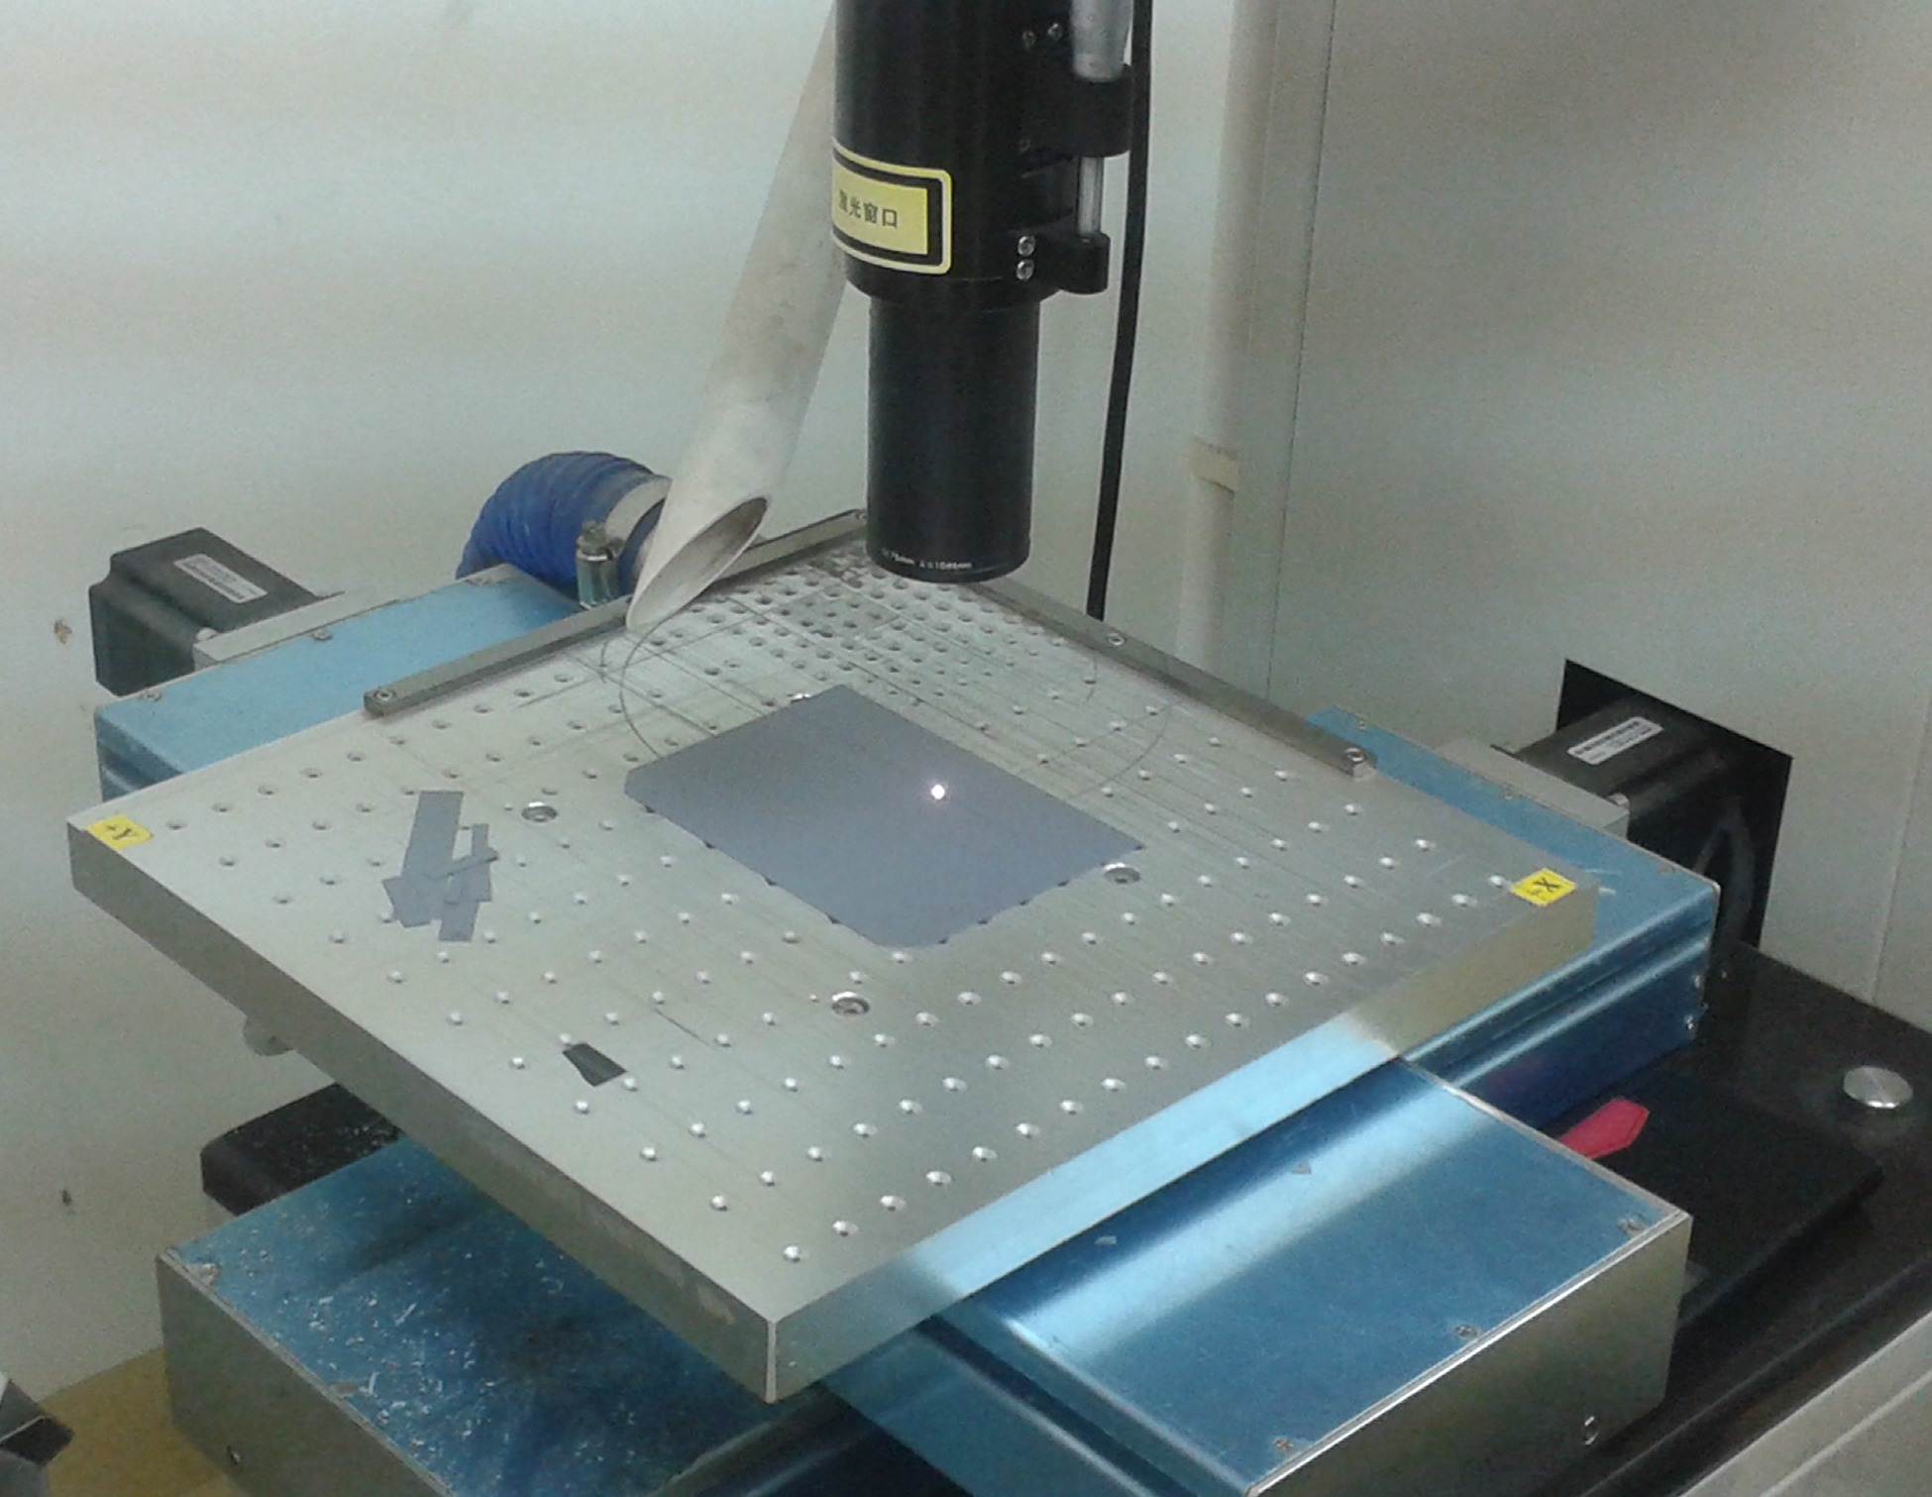
LASER Cutter

Slide 27
Febry Pérot Laser Diode
Basics of Febry Pérot Laser:
It consists of two flat reflecting mirrors feeding each other.
The losses of some frequencies are compensated because this cavity has gain mechanism.
Standing wave with longitudinal wave can only propagated.

Slide 28
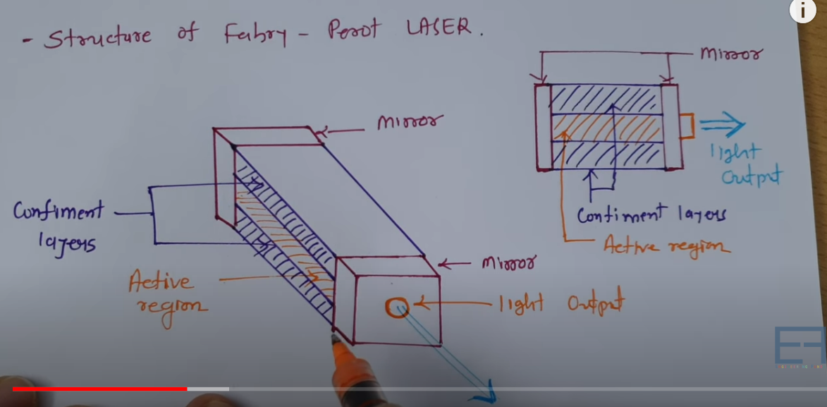

Slide 29
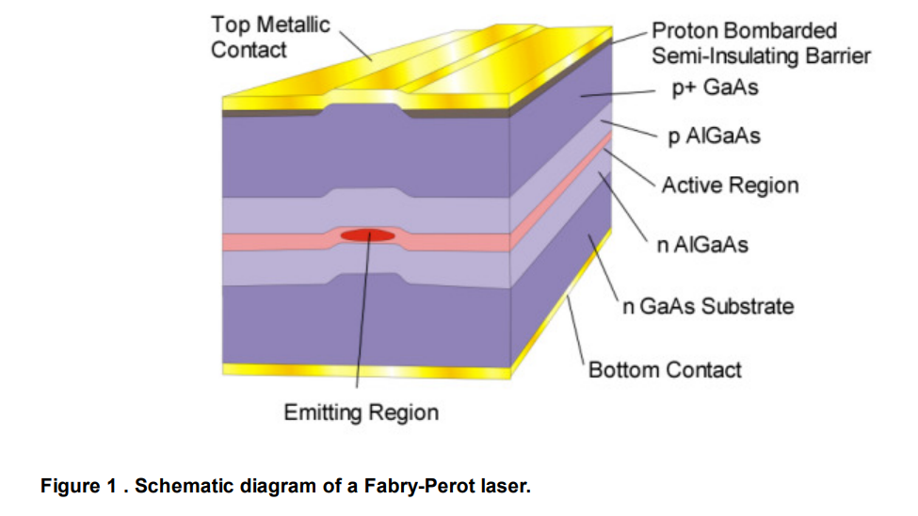

Slide 30
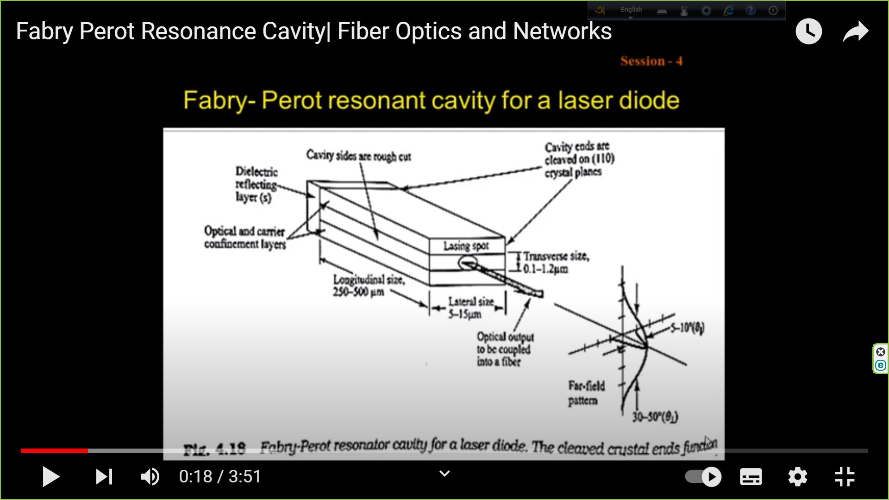

Slide 31
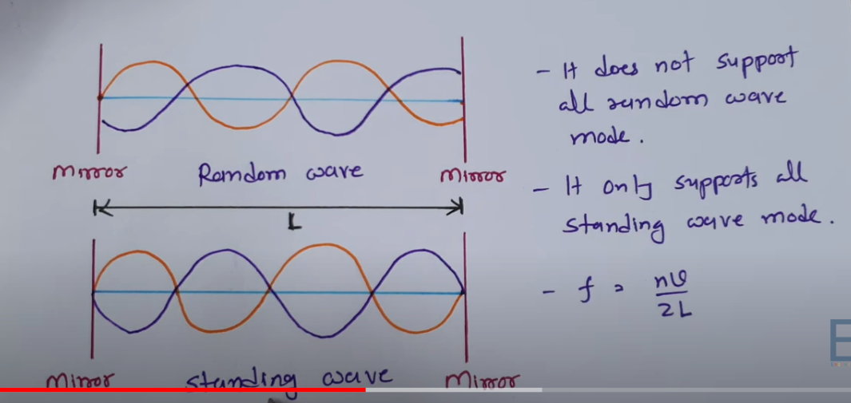

Slide 32
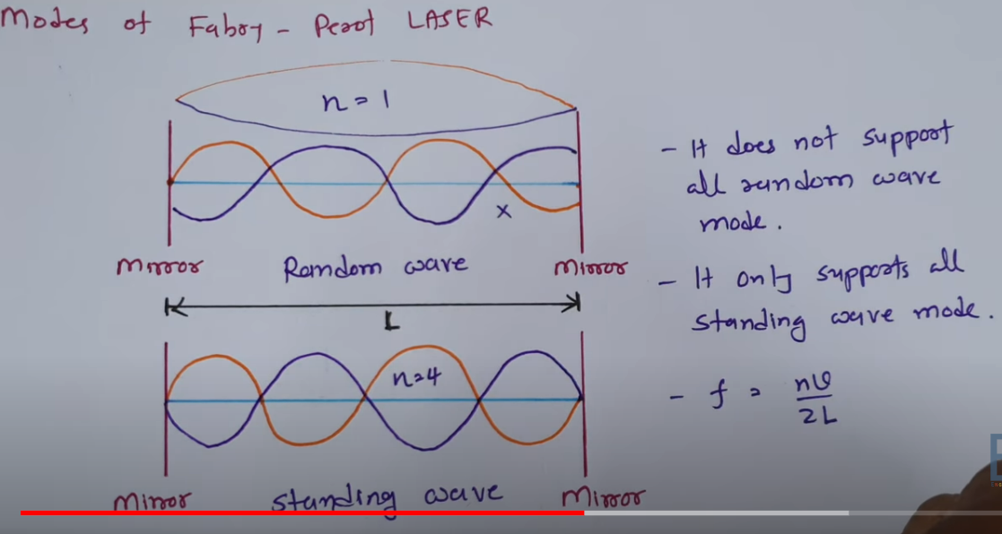

Slide 33
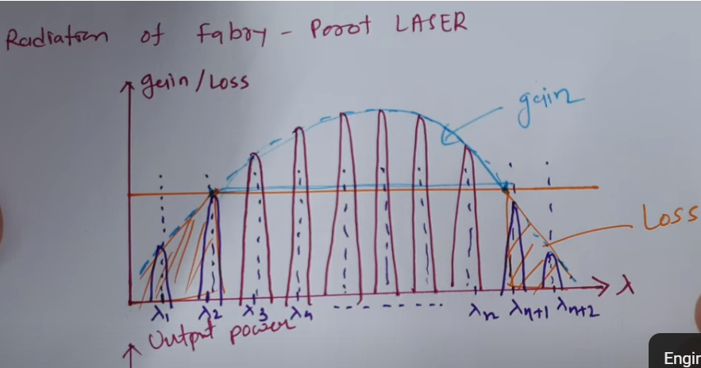

Slide 34
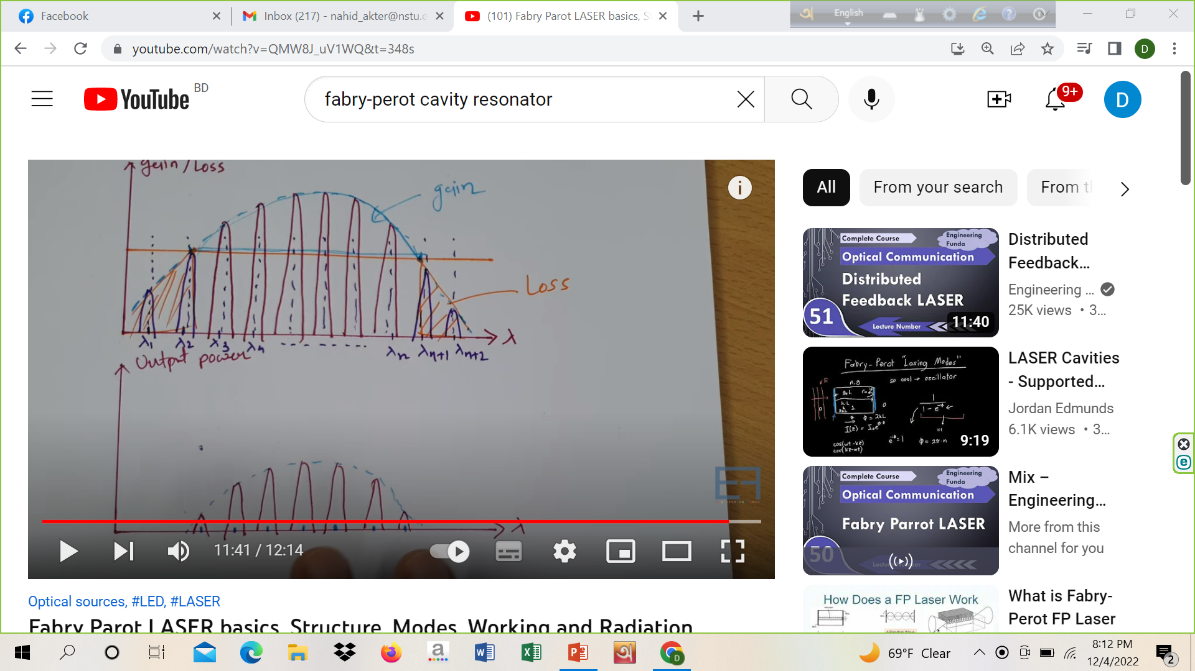
Ref. link: https://www.youtube.com/watch?v=QMW8J_uV1WQ

Slide 35
Febry Pérot LD
A Fabry–Pérot laser diode (FP laser diode) is the most common type of laser diode, having a laser resonator which is a Fabry–Pérot interferometer.
The threshold pump power may be low enough, and about half of the optical output power is obtained at each side.

Slide 36
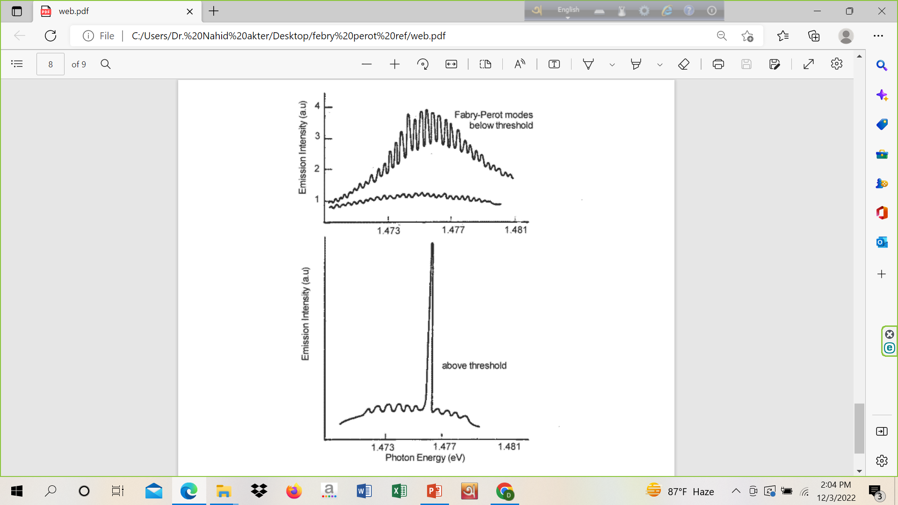
Emission spectra of an edge-emitting laser below threshold and above

Slide 37
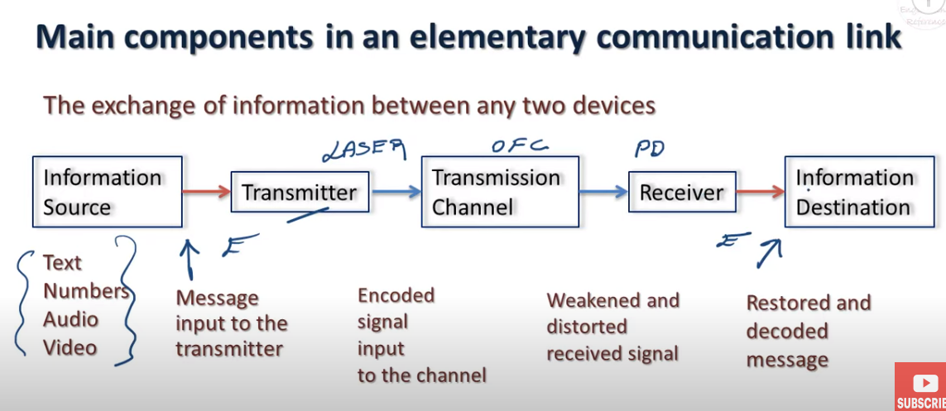
Functional Block Diagram of General Tx-Rx

Slide 38
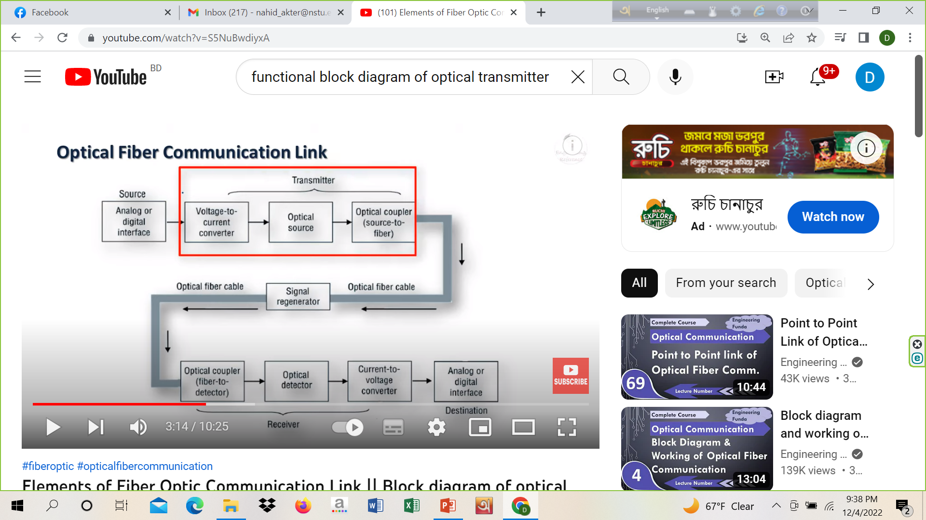
Functional Block Diagram of Optical Tx-Rx

Slide 39
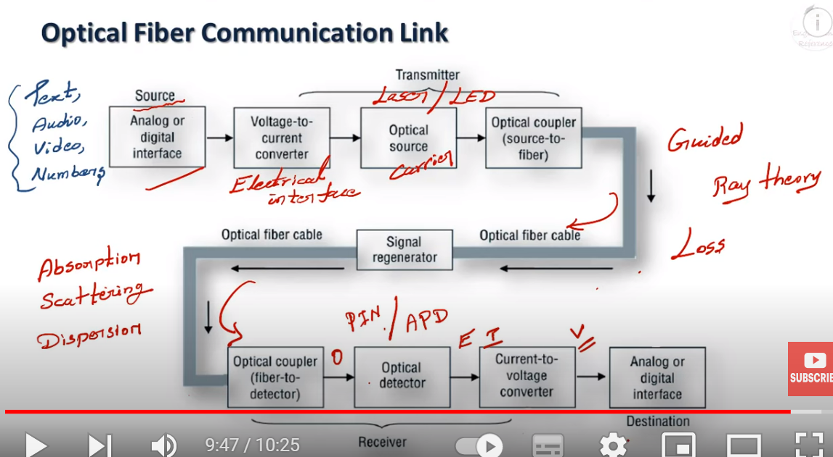
Functional Block Diagram of Optical Tx-Rx

